Slide 1

Social media application
BY:
AASHIL.NAIDU
SUJITH.R
SHILPA.S
MINAZ.M
AYUSH.K
Sandhya.j

Slide 2

Contents
Abstract
Introduction
Types of social media
Socailavey
BRS Database Of Socialavey
Modules of the Project
Advantages & Disadvantages
Reference
Conclusion

Slide 3
Abstract
Social media is an internet-based form of communication.
Social media platforms allow users to have conversations, share information and create web content
There are many forms of social media, including blogs, micro-blogs, wikis, social networking sites, photo-sharing sites, instant messaging, video-sharing sites, podcasts, widgets, virtual worlds, and more.
Billions of people around the world use social media to share information and make connections.
On a personal level, social media allows you to communicate with friends and family, learn new things, develop your interests, and be entertained.
At the company level, social media allows you to have a conversation with your audience, gain customer feedback, and elevate your brand.

Slide 4
Introduction
Social media is a web‐based technology to facilitate social interaction between a large group of people through some type of network.
Social media is growing rapidly and becoming an inevitable part of everyday life, because of the latest technological revolution
The mobile versions of these social media sites are so easy to access made it user friendly. As well as the Map services made a remarkable usage through mobile to find direction and places easily.
Strength of Social Media
Around 112.3 million blogs
100 Million of videos viewed daily
60 million active social network site users

Slide 5





Types of Social Media Application
Linkedln – 810 million users Twitter – 206 million users
Facebook- 2.17 Billion users
What’s app – 2 billion users
Instagram – 1.386 Billion users

Slide 6

Socialavey
Socailavey is a social media application were we help people to connect with each other.
We serve the public conversation.
Give people the power to build community and ring the world closer together.
Connect with more people , build influence , and create compelling content that’s distinctly yours.

Slide 7
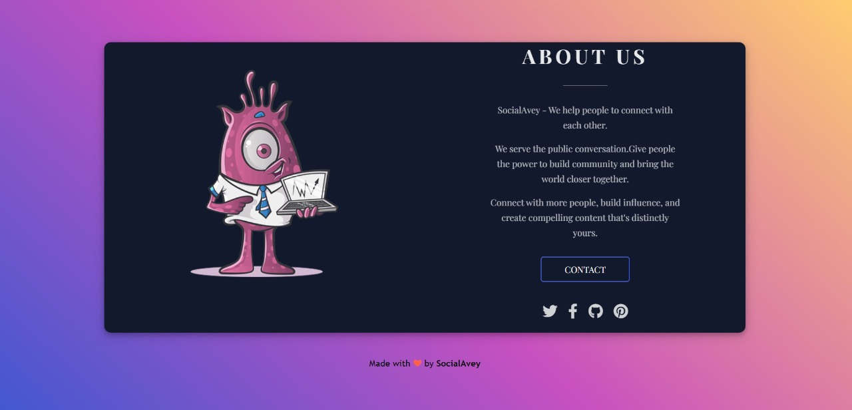

Slide 8
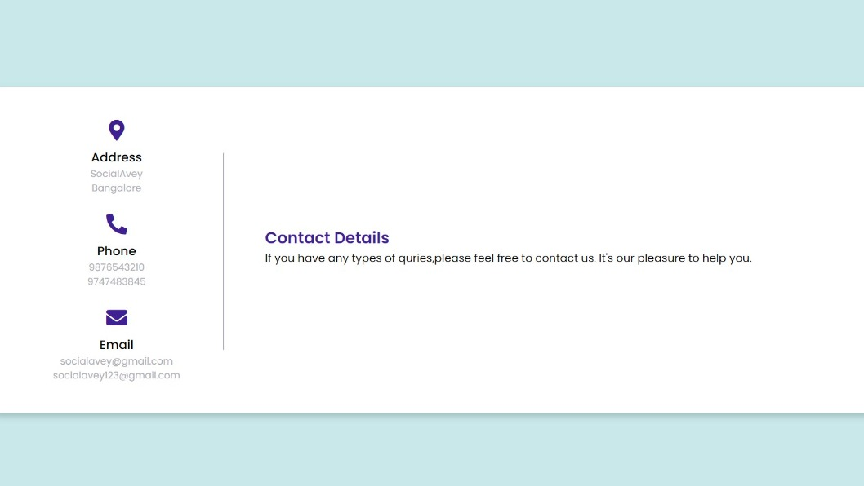

Slide 9

BRS of Socialavey
The social media web application what we are implementing in our project is “SOCIALAVEY”.
2. Key features of our web application consist of: - Is to share post, chatting with friends, maintain a secure profile, make comment on posts
Goals of the project :-
The main goal of socialavey is to connect with people
Having the knowledge of current events.
Increase the number of users.
b. Solution/Proposed system :-
1.The socialavey have its own database to store all the user profiles.
2. It have features like posting, edit profile ,edit post, delete post, comment on post, chat with friends and like on post.
3. The socailavey had overcome the problem of previous existing systems of Twitter like by increasing number of characters that can be posted and also it has a unique user profile viewing system.

Slide 10
Requirements :- a. Functional requirements. b. Non-functional requirements. a. Functional requirements:- 1.User Requirements: - • Content to be created and published in the system such as images, posts, comments. • User management system :- ➢ Key factors for user management: i. Creating unique profiles for new users. ii. User can share their profile to other users. iii. There is a data base for every user so to create a secure profile for every user. 2. Technical Requirements: - i. Python, flask, html and CSS. ii. WebSocket I/O. b. Non-functional requirements: • The application has the capacity to generate a post and create post within a fraction of seconds. • The user can create user profile (sign up, sign in) within 5 seconds. • There is no character limit for the post what the users will upload on their profile

Slide 11
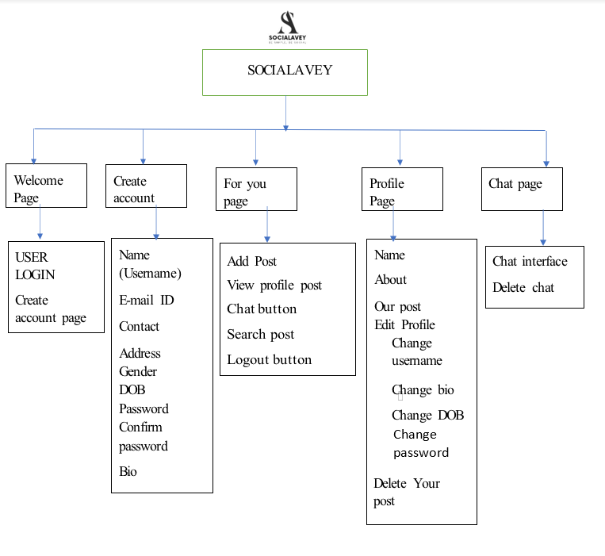
Architecture Diagram

Slide 12

Modules of Socialavey

Slide 13

Modules of Socialavey are:
HOME Module
2. REGISTRATION Module
3. LOGIN Module
4. FOR YOU Module
5. PROFILE Module
6. CHAT Module

Slide 14

Home Module

Slide 15
Home page is the is the main page of the website.
The term may also refer to the start page shown in web browser when the application first opens.
It is default web page that loads when you visit a web address that only contains the domain name.
The home page is located in the root dictionary of the website
Most web severs allow the home page to have one or several different file names.
Index.html
Default.html
Index.htm
Index.php
Since the home page file is loaded automatically from the root directory , the home page URL does not need to include the file name.

Slide 16
Registration Module:
A signup page (also known as a registration page) enables users and organizations to independently register and gain access to your system
It is common to have multiple signup pages depending on the types of people and organizations you want to register.
For using the Socialavey application new users has to sign-up (register) at the start.
The sign-up button is also provided at the homepage
The new users has to give their basic details for sign-up.
Once the user has completed the registration or sign-up page they can login using the email and password which they had set in the sign-up page.

Slide 17
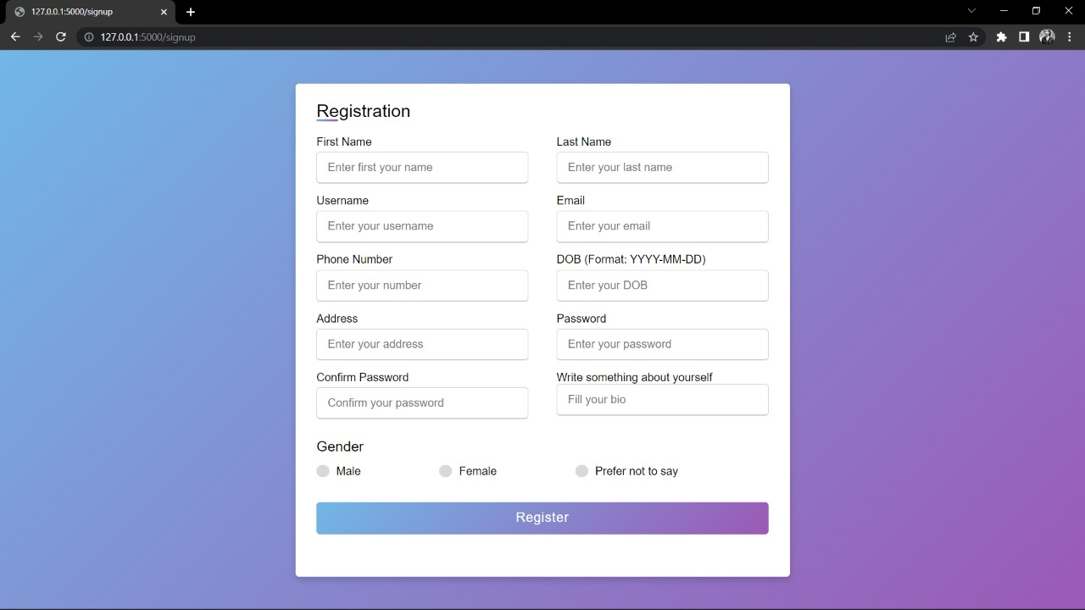

Slide 18

Login Module

Slide 19

In the home page there is a login button where the new user can login after the sign-up or the registration process has been done.
The new user has to enter the E-mail id and password which was given while registering to the app.
Once the user enters the email id and the password and after entering the login button the for you page (profile page) will be open for the users

Slide 20
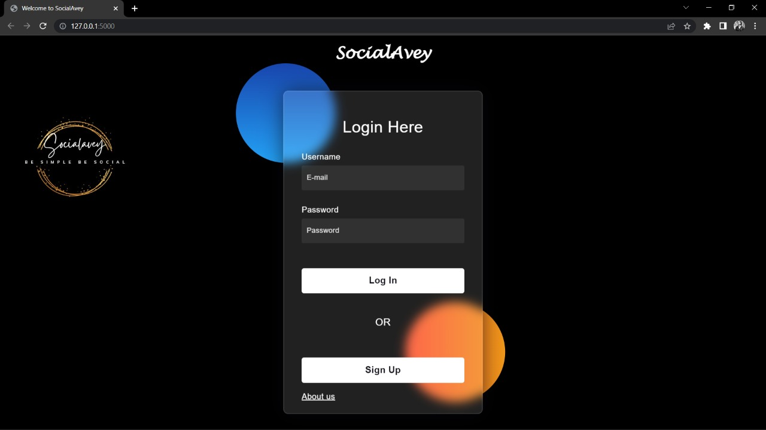

Slide 21
For You Module

Slide 22
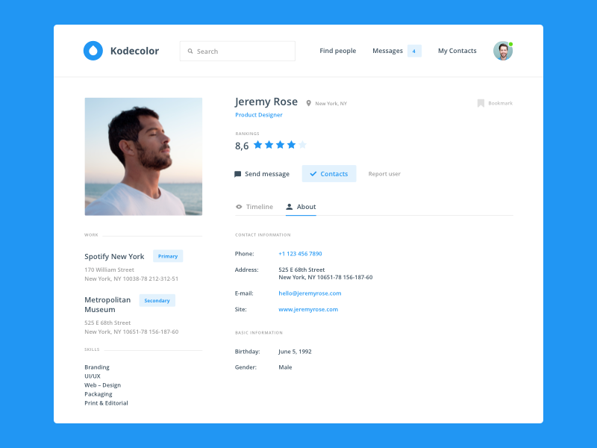
After the login process the user will be redirected to the for you page or the profile page .
In this page users can post their pictures
And one user can view other user post
Users can also edit their profiles , usernames , and about .
Users can do multiple operations in this for you page like opening profile page and chat page.
And there is a logout option were the user can logout form the app

Slide 23
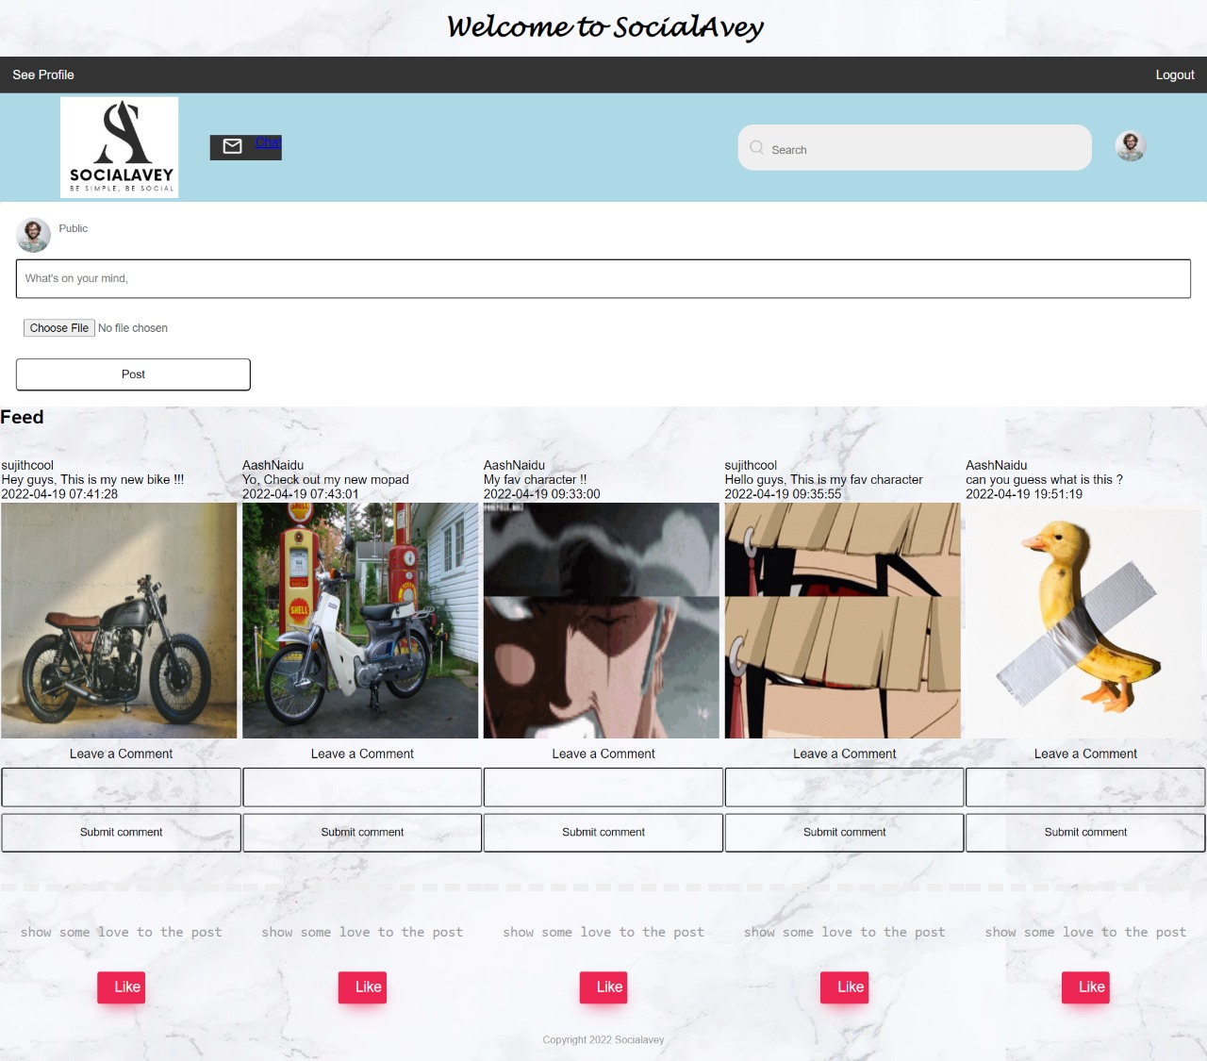

Slide 24

Profile Module

Slide 25
When the user login through the login page/module the profile page will open for the user.
The profile page contains the username , name of the user , date of birth of the user as basic details .
It has the counts of posts that the user had posted on his profile.
We can see the bio of the user had posted on his profile
We can see the bio of the user and the user name of the user in the slide bar.
There is edit profile button where user can edit name user name , email , id, date of birth, password and confirm password.

Slide 26
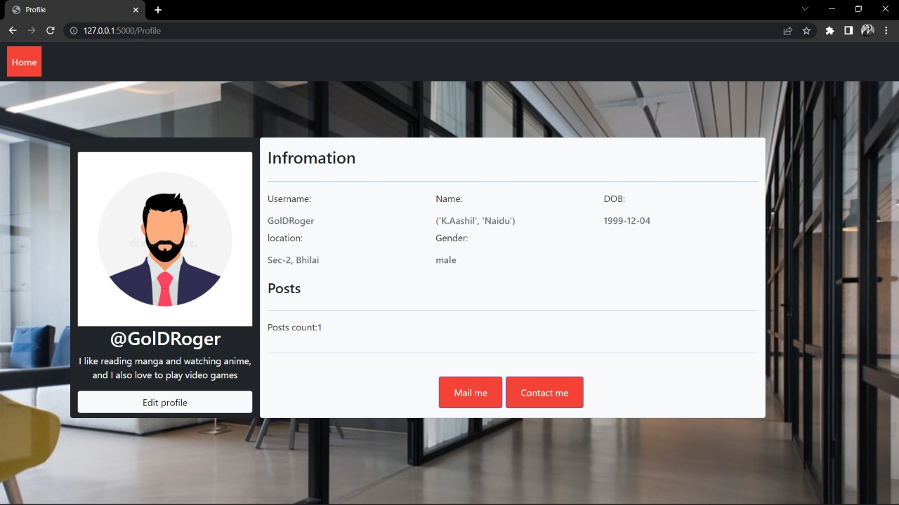

Slide 27
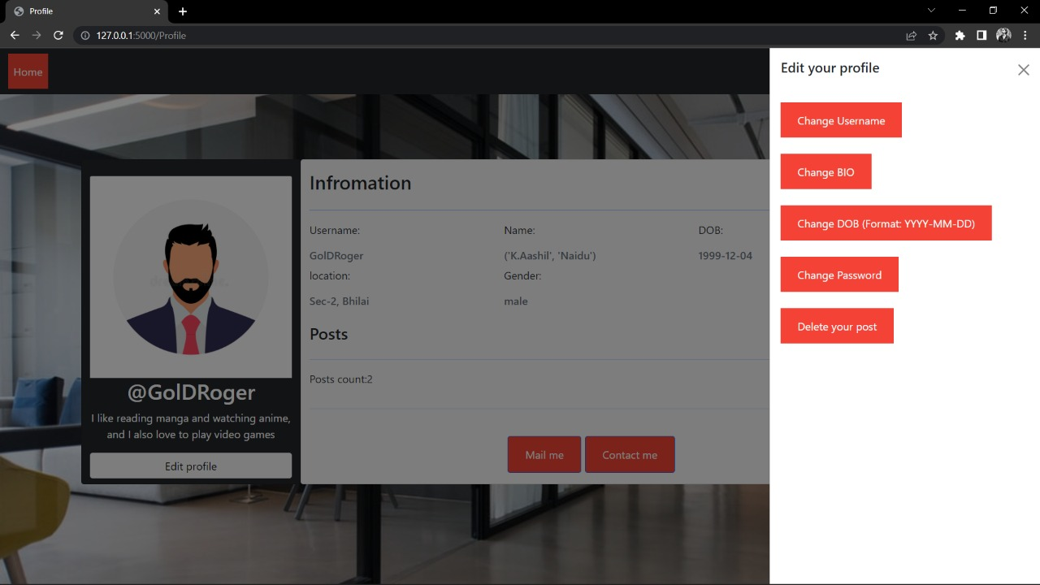

Slide 28

Chat Module

Slide 29

The chat feature allows users to communicate with each other.
This chat feature allows users to discuss topics , even help each other out in understanding things that might confuse them.
By this they can build and boost their social and interpersonal skillset.
And meeting people with similar interests , meeting new people , staying in touch with friends and family .

Slide 30
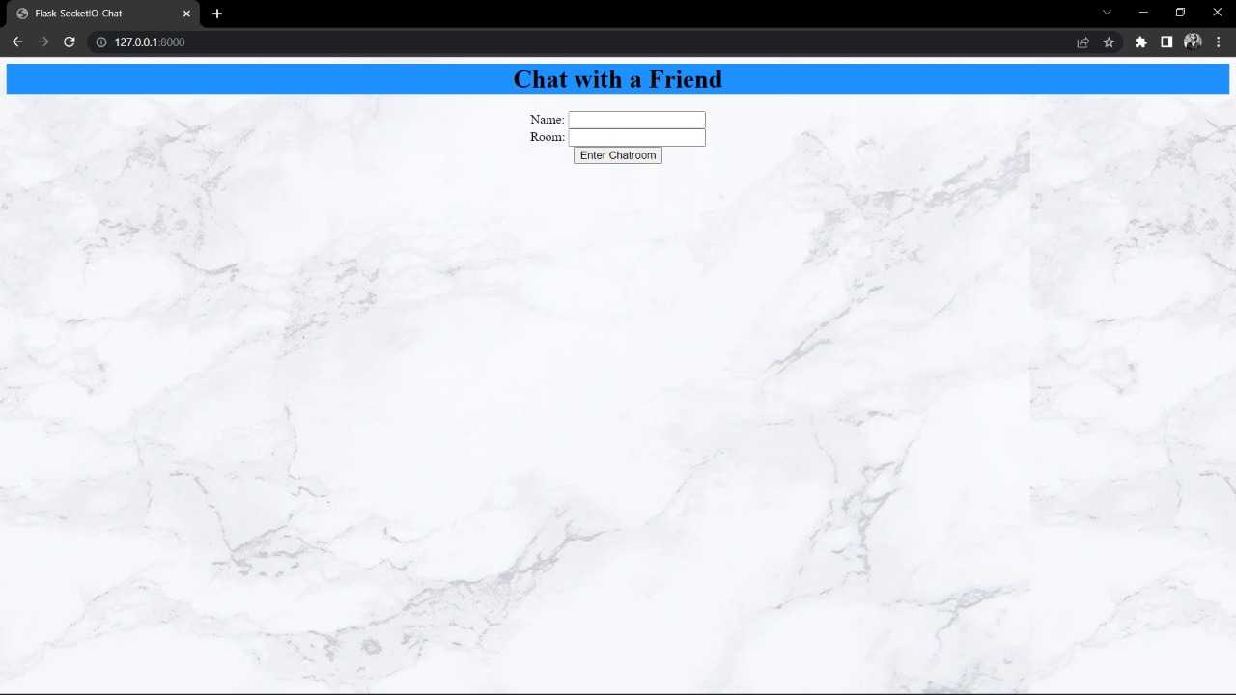
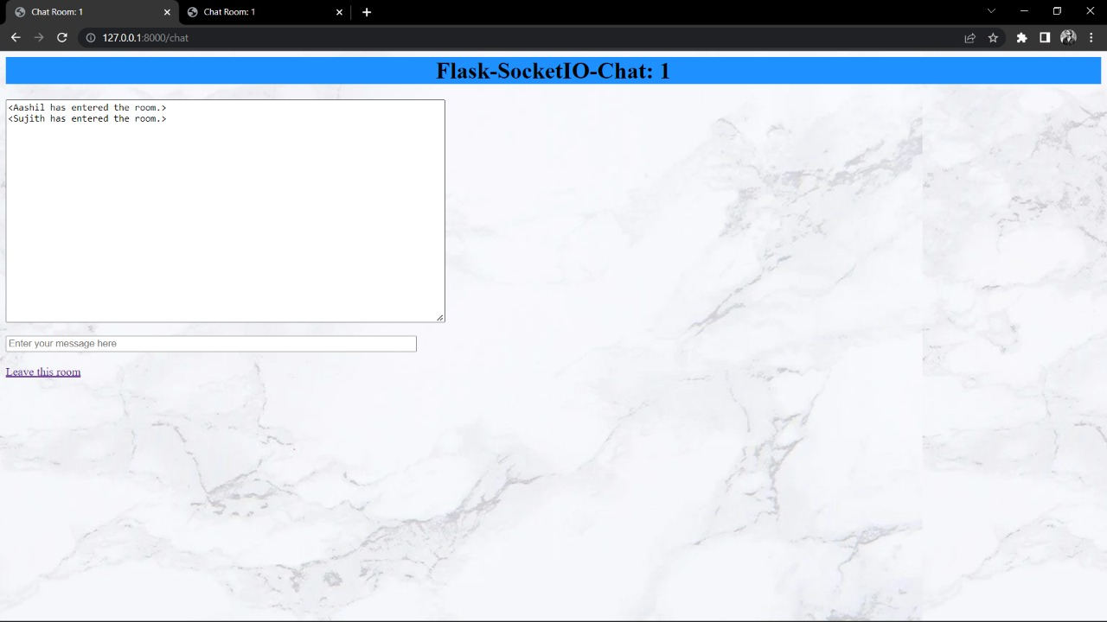

Slide 31
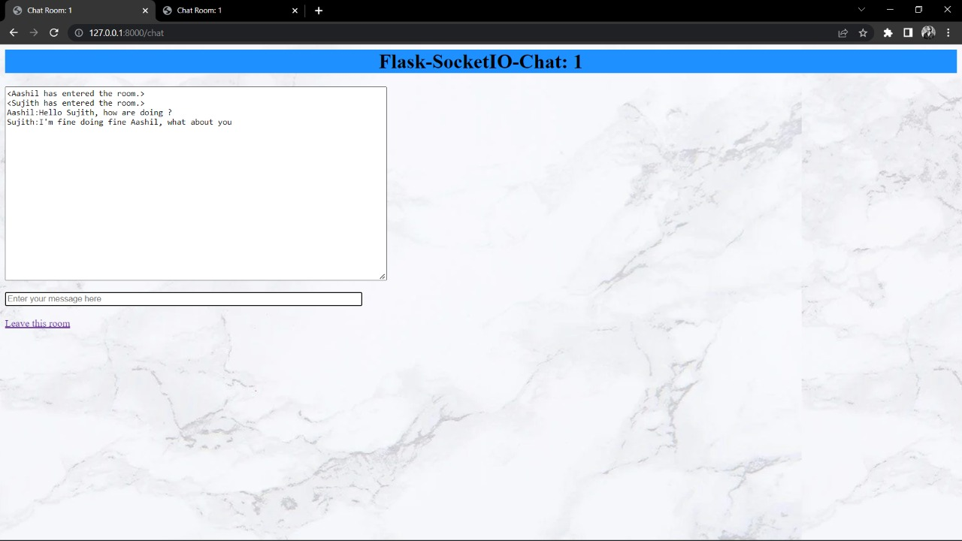

Slide 32
Advantages and Disadvantages of social media application
ADVANTAGES
DISADVANTAGES
Educational process
Worldwide connectivity
Online marketing
Information spreads fast
It lets us share everything with others
Privacy problems
Lacks emotional connect
Changes lifestyle habit and sleep distrubtion
Reduces family intimacy

Slide 33
Conclusion
Social media has taken its position into the real world and has interfered with the lives of many. As users log on to their social media profiles, they are being removed away from the real world and placed into the virtual dimension.
As they grow they are bombarded with images and stereotypes of the perfect person, not truly being able to enjoy their advantages and qualities that overpower the bad ones.
Social media changed our life so much. Our life became more convenient because social media is a very useful tool for us in 21st century, it could help us to improve our life. However, we have to aware of how we use them. If we could use the social media smartly, having social media will become a good change for us.

Slide 34

Test Cases

Slide 35
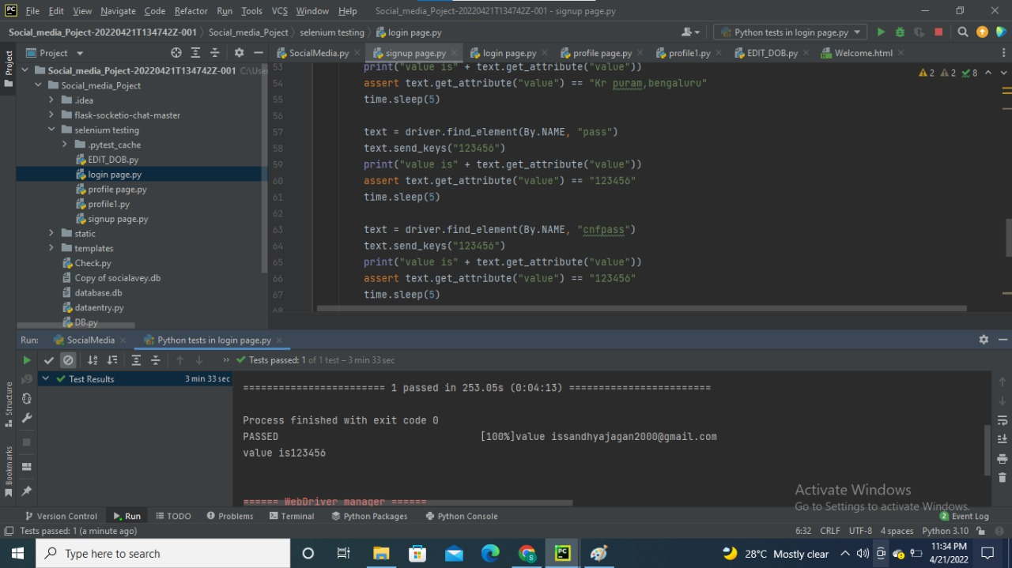
Login Module

Slide 36
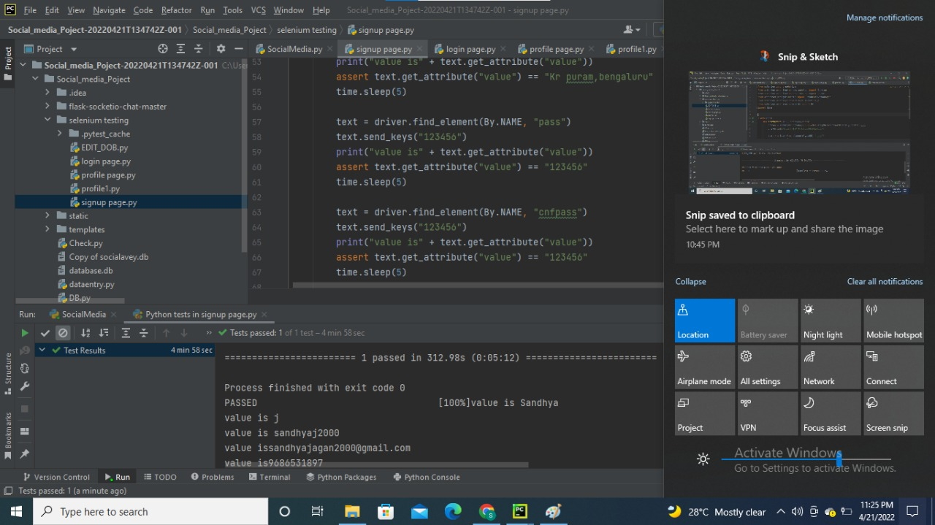
Sign-Up Module

Slide 37
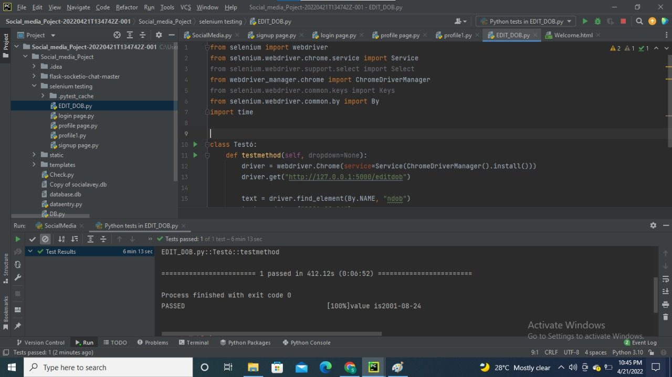
Test case to edit DOB

Slide 38
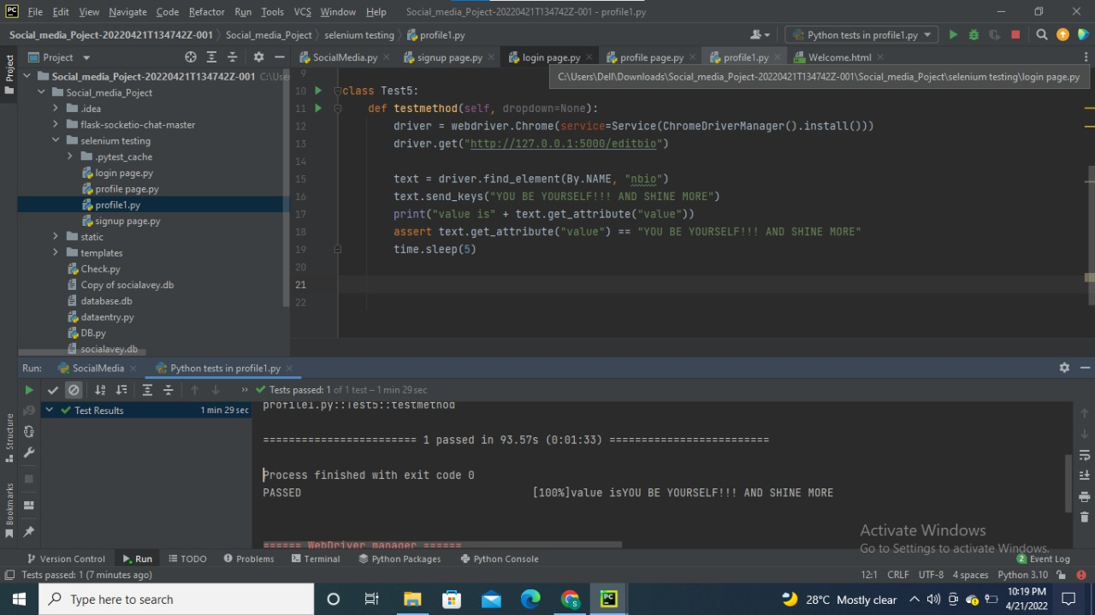
Test case to edit BIO

Slide 39
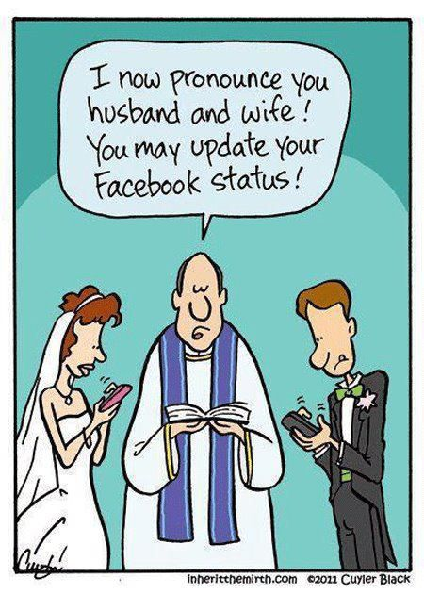
THANK YOU

